Slide 1
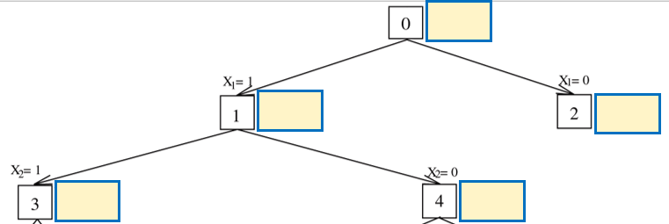
LB: -19
UB: -17
LB: -19
UB: -17
LB: -16
UB: -14
LB: -19
UB: -17
LB: -17
UB: -15

